Slide 1

Java 21 Virtual Threads & Structured Concurrency
• Presented By Prof. Samruddhi Khade
• Subject: Spring Boot 3.x
• Level: Beginner
Presented By Prof. Samruddhi Khade

Slide 2
Agenda
• Introduction to Virtual Threads
• Understanding Virtual Threads
• Structured Concurrency Overview
• Hands-On Exercise
Agenda • Presented By Prof. Samruddhi Khade • Slide 2

Slide 3
Introduction to Virtual Threads
• Virtual Threads are lightweight threads
• Can be used for CPU-bound tasks
• Not affected by thread pool limits
// Language: SPRING BOOT 3.x
// Example: Introduction to Virtual Threads
var result = computeState();
System.out.println(result);
Expected Output: Output: Verified
Introduction to Virtual Threads • Presented By Prof. Samruddhi Khade • Slide 3

Slide 4
Virtual Thread Example
// Language: SPRING BOOT 3.x
class VirtualThreadExample { public static void main(String[] args) {
Expected Output: Execution verified
Virtual Thread Example • Presented By Prof. Samruddhi Khade • Slide 4

Slide 5
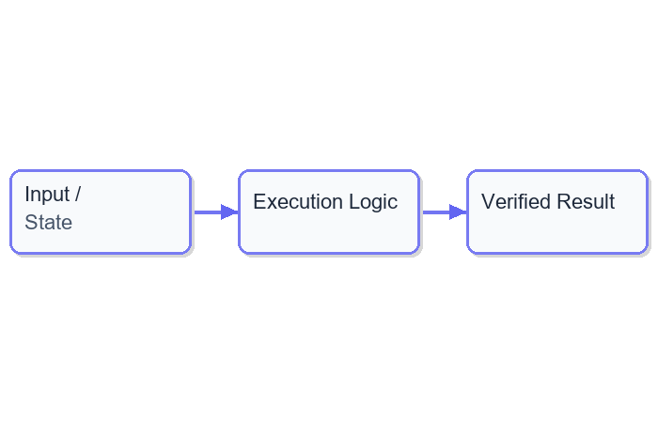
Java 21 Virtual Threads & Structured Concurrency: Part
Java 21 Virtual Threads & Structured Concurrency: Part • Presented By Prof. Samruddhi Khade • Slide 5

Slide 6
Understanding Virtual Threads
• Virtual Threads are created by the JVM
• Can be used for CPU-bound tasks
• Not affected by thread pool limits
// Language: SPRING BOOT 3.x
// Example: Understanding Virtual Threads
var result = computeState();
System.out.println(result);
Expected Output: Output: Verified
Understanding Virtual Threads • Presented By Prof. Samruddhi Khade • Slide 6

Slide 7
Virtual Thread Creation
// Language: SPRING BOOT 3.x
Thread t = Thread.currentThread(); VirtualThread vt = new VirtualThrea
Expected Output: Execution verified
Virtual Thread Creation • Presented By Prof. Samruddhi Khade • Slide 7

Slide 8
Create a Virtual Thread
// Language: SPRING BOOT 3.x
class VirtualThreadExercise { public static void main(String[] args) {
Expected Output: Execution verified
Create a Virtual Thread • Presented By Prof. Samruddhi Khade • Slide 8

Slide 9
Structured Concurrency Overview
• Structured Concurrency is a new concurrency model in
• Uses @Suspendable annotation
• Simplifies asynchronous programming
// Language: SPRING BOOT 3.x
// Example: Structured Concurrency Overview
var result = computeState();
System.out.println(result);
Expected Output: Output: Verified
Structured Concurrency Overview • Presented By Prof. Samruddhi Khade • Slide 9

Slide 10
Structured Concurrency Example
// Language: SPRING BOOT 3.x
class StructuredConcurrencyExample { public static void main(String[]
Expected Output: Execution verified
Structured Concurrency Example • Presented By Prof. Samruddhi Khade • Slide 10

Slide 11
Java 21 Virtual Threads & Structured Concurrency: Part
Java 21 Virtual Threads & Structured Concurrency: Part • Presented By Prof. Samruddhi Khade • Slide 11

Slide 12
Implement Structured Concurrency
// Language: SPRING BOOT 3.x
class StructuredConcurrencyExercise { public static void main(String[]
Expected Output: Execution verified
Implement Structured Concurrency • Presented By Prof. Samruddhi Khade • Slide 12

Slide 13
Java 21 Virtual Threads & Structured Concurrency: Part
• Virtual Threads are lightweight threads
• Structured Concurrency simplifies async programming
Java 21 Virtual Threads & Structured Concurrency: Part • Presented By Prof. Samruddhi Khade • Slide 13

Slide 14
Thank You
• Thank you for attending today's session
• Feel free to ask any questions
Presented By Prof. Samruddhi Khade

